Slide 1



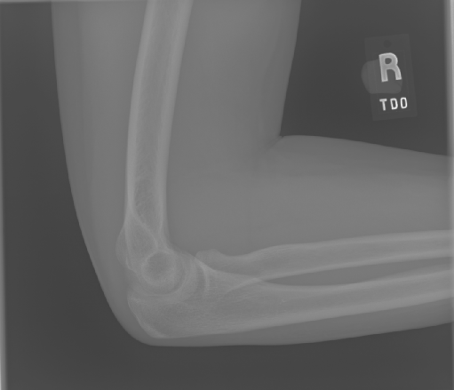
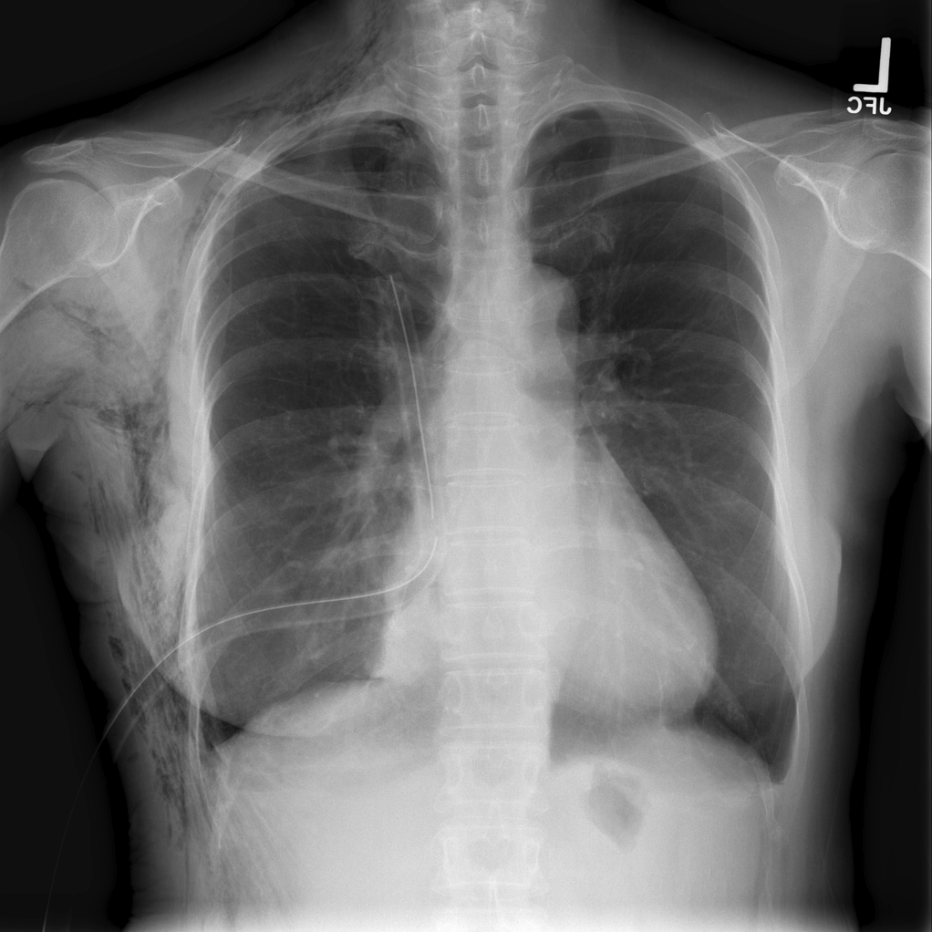
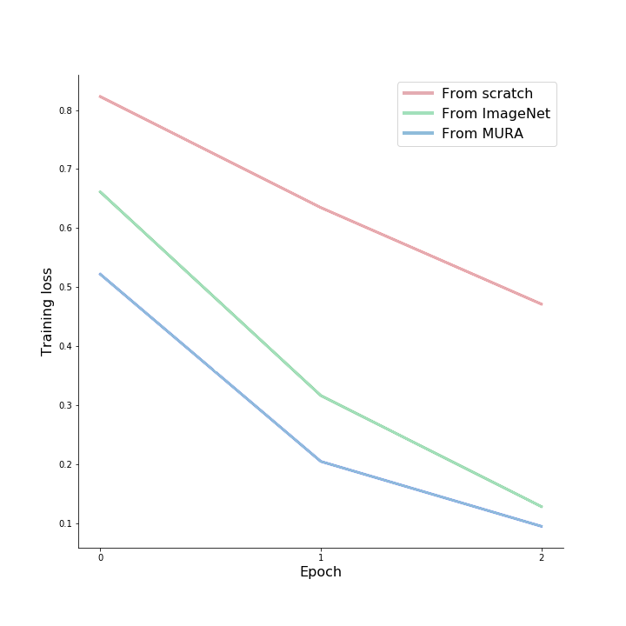
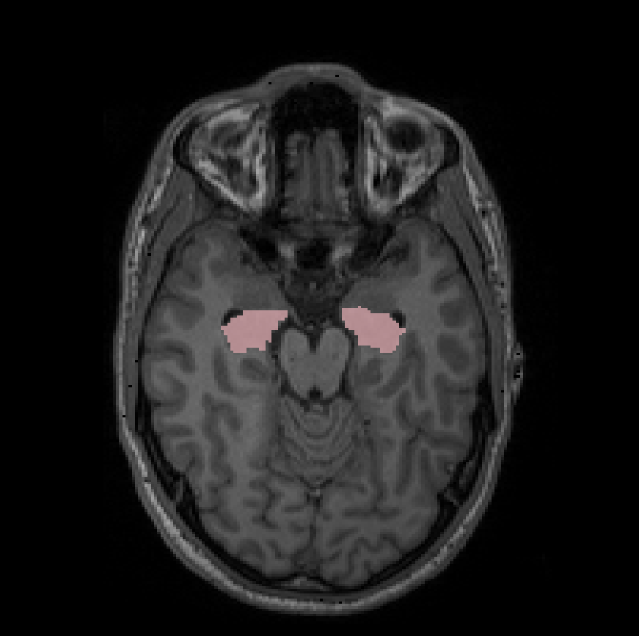
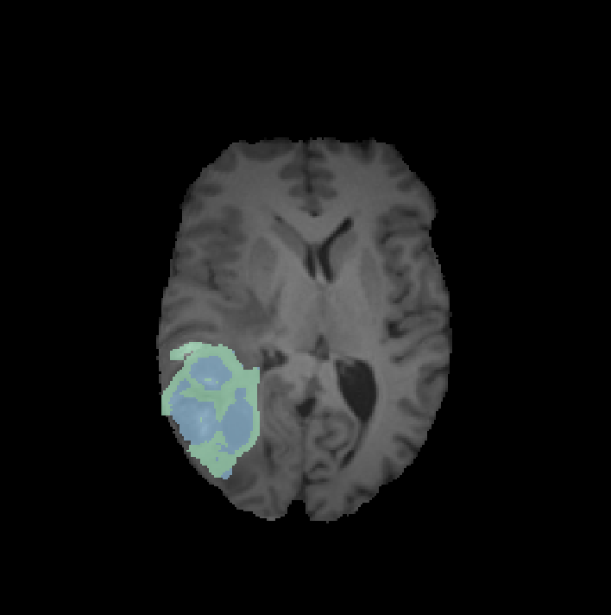
Transfer learning in medical images
a case study
Satheshkumar Kaliyugarasan^{1,2}; Alexander Selvikvåg Lundervold^{2,3}
¹Department of biomedicine, UiB; ²Mohn Medical Imaging and Visualization Centre, HUS;
³Department of Computer Science, Electrical Engineering, and Mathematical Sciences, HVL
Introduction
Experimental setting
Methods and Materials
Discussion and conclusion
A common stumbling block for supervised learning methods based on deep neural networks is the large number of labeled examples required for training. This is a problem when applying deep learning methods in medical imaging due to the often time-consuming, difficult and unreliable annotation processes.
One way to alleviate this problem is to use transfer learning [1]. It is a very natural idea, informed by our own approach to learning: People often learn something in one context which informs how well they learn and perform in other context.
For convolutional neural networks (CNN), the weights are typically randomly initialized, often using the so-called He initialization. However, as the layers in a CNN often end up learning basic features that are common across different kinds of images [1], it is often better to initialize the weights from another network trained to perform a similar task. This is a form of transfer learning, also called fine-tuning or pre-training.
The technique is used by almost all two-dimensional CNNs designed for tasks involving images: the weights of the network are initialized from a network trained on the ImageNet challenge dataset, a collection of 1.4 million labelled images from 1000 different categories.
The effect of transferring weights from other tasks is however less well-studied.
The idea investigated in this work is the effect of indirect transfer from ImageNet to our target network, by first passing through another dataset more similar to our target dataset. The idea is illustrated in Figure 1.
To evaluate this approach, we chose as our target objective detection the detection of pneumothorax from chest X-rays (Figure 3), passing through a large, annotated dataset of skeletal X-rays (Figure 2).
We compare the results with a network trained from scratch on the chest X-rays and with a network whose weights were initialized using a ImageNet-trained network.
Our models were all trained using the following regime:
Optimizer: Adam
Learning rate: Base learning rate 0.0001, with scaled down learning rates for earlier layers when using transfer learning (i.e. discriminative learning rates)
Data augmentation: Random horizontal flips
Image sizes: 299 x 299
Batch size: 16
GPU: NVIDIA GTX 1080 Ti
Model: Pytorch’s DenseNet121, with the last layer removed and the following added: AdaptiveConcatPool2d, AdaptiveMaxPool2d, BatchNorm, Linear, BatchNorm, Linear, LogSoftmax
The results indicate the value of our approach. We expect that transferring weights from a more accurate network would lead to a more significant effect. As the ChestX-ray dataset contains a lot of label noise, it would be worthwhile to swap it out with a different data set.
This project is part of our larger-scale effort to investigate the value of transfer learning for medical images, particularly 3D images.
See e.g, [6], where we created a 3D CNN for segmentation of left and right kidneys from DCE-MRI, pre-trained on the task of left and right segmentation of the hippocampus in T1-weighted MR images.
More recently, we trained a high-resolution, 3D CNN implemented in the NiftyNet library on the task of segmenting hippocampus, and fine-tuned this network to segment tumor core in a smaller MRI dataset, see e.g, [8].
We plan to extend the fastai library with 3D capabilities, enabling even more powerful transfer learning techniques.
Figure 2: MURA image
Figure 3: Chest X-ray image
Results
Following the approach taken by the CheXNet study from Andrew Ng’s Stanford ML group [2], we used a DenseNet121 network with some additional layers on the top (see Experimental setting for details).
To construct and train our networks, we used PyTorch via the fast.ai deep learning library [3].
Our networks were trained on the following two datasets:
Mura dataset containing 40,895 musculoskeletal X-ray images from 14,982 studies, where each study is labeled as either normal or abnormal (5,915 abnormal studies, containing a total of 15,117 images) [4].
ChestX-ray14 dataset containing 112,120 frontal-view X-ray images from 30,805 unique patients, each of them labeled with up to 14 different diseases [5]. Of these, we used 53137 in our study (50500 no diagnosis and 2637 pneumothorax).
Figure 4: Training loss for our models
As we can observe in figure 4, the pre-trained models learn significantly faster than the model trained from scratch. In addition, the model whose weights were initialized from the MURA network reaches a lower training loss quicker.
This illustrates how our approach to transfer learning leads to less need for training data: a given loss value is reached earlier for the network pre-trained on ImageNet and then MURA compared to the network pre-trained only on ImageNet.
The difficulty of the two medical imaging tasks (abnormality detection from skeletal and chest X-rays) led to test set accuracies below 85% (MURA: 83% for study-wise predictions of each XR type; Pneumothorax: 82%).
Our source code for this study is publicly available at: https://github.com/skaliy/Deep_Learning_Kaliy
Figure 5: Transferring from one 3D medical imaging task to another
Acknowledgments
Our work was supported by the Trond Mohn Research Foundation.
References
Yosinski, J., et al. "How transferable are features in deep neural networks?." Advances in neural information processing systems. 2014.
Rajpurkar, P., et al. "CheXNet: Radiologist-Level Pneumonia Detection on Chest X-Rays with Deep Learning." arXiv preprint arXiv:1711.05225 (2017).
Howard, J. Fastai. https://github.com/fastai/fastai.
Rajpurkar, P., et al. "MURA Dataset: Towards Radiologist-Level Abnormality Detection in Musculoskeletal Radiographs." arXiv preprint arXiv:1712.06957 (2017).
Wang, X, et al. "Chestx-ray8: Hospital-scale chest x-ray database and benchmarks on weakly-supervised classification and localization of common thorax diseases." CVPR 2017
A. S. Lundervold et.al. Fast semi-supervised segmentation of the kidneys in DCE-MRI using convolutional neural networks and transfer learning. Functional Renal Imaging: Where Physiology, Nephrology, Radiology and Physics Meet, Berlin, Oct. 2017
S. Kaliyugarasan "Deep transfer learning in medical imaging." BORA - UiB (2019)
Abundant data
Lots of data
Less data
Model A
Model B
Model C
Figure 1: Transferring knowledge from one task to another

Slide 2
Transfer learning in medical images
a case study
Satheshkumar Kaliyugarasan^{1,2}; Alexander Selvikvåg Lundervold^{2,3}
¹Department of biomedicine, UiB; ²Mohn Medical Imaging and Visualization Centre, HUS;
³Department of Computer Science, Electrical Engineering, and Mathematical Sciences, HVL
Introduction
Experimental setting
Methods and Materials
Discussion and conclusion
A common stumbling block for supervised learning methods based on deep neural networks is the large number of labeled examples required for training. This is a problem when applying deep learning methods in medical imaging due to the often time-consuming, difficult and unreliable annotation processes.
One way to alleviate this problem is to use transfer learning [1]. It is a very natural idea, informed by our own approach to learning: People often learn something in one context which informs how well they learn and perform in other context.
For convolutional neural networks (CNN), the weights are typically randomly initialized, often using the so-called He initialization. However, as the layers in a CNN often end up learning basic features that are common across different kinds of images [1], it is often better to initialize the weights from another network trained to perform a similar task. This is a form of transfer learning, also called fine-tuning or pre-training.
The technique is used by almost all two-dimensional CNNs designed for tasks involving images: the weights of the network are initialized from a network trained on the ImageNet challenge dataset, a collection of 1.4 million labelled images from 1000 different categories.
The effect of transferring weights from other tasks is however less well-studied.
The idea investigated in this work is the effect of indirect transfer from ImageNet to our target network, by first passing through another dataset more similar to our target dataset. The idea is illustrated in Figure 1.
To evaluate this approach, we chose as our target objective detection the detection of pneumothorax from chest X-rays (Figure 3), passing through a large, annotated dataset of skeletal X-rays (Figure 2).
We compare the results with a network trained from scratch on the chest X-rays and with a network whose weights were initialized using a ImageNet-trained network.
Our models were all trained using the following regime:
Optimizer: Adam
Learning rate: Base learning rate 0.0001, with scaled down learning rates for earlier layers when using transfer learning (i.e. discriminative learning rates)
Data augmentation: Random horizontal flips
Image sizes: 299 x 299
Batch size: 16
GPU: NVIDIA GTX 1080 Ti
Model: Pytorch’s DenseNet121, with the last layer removed and the following added: AdaptiveConcatPool2d, AdaptiveMaxPool2d, BatchNorm, Linear, BatchNorm, Linear, LogSoftmax
The results indicate the value of our approach. We expect that transferring weights from a more accurate network would lead to a more significant effect. As the ChestX-ray dataset contains a lot of label noise, it would be worthwhile to swap it out with a different data set.
This project is part of our larger-scale effort to investigate the value of transfer learning for medical images, particularly 3D images.
See e.g, [6], where we created a 3D CNN for segmentation of left and right kidneys from DCE-MRI, pre-trained on the task of left and right segmentation of the hippocampus in T1-weighted MR images.
More recently, we trained a high-resolution, 3D CNN implemented in the NiftyNet library on the task of segmenting hippocampus, and fine-tuned this network to segment tumor core in a smaller MRI dataset, see e.g, [8].
We plan to extend the fastai library with 3D capabilities, enabling even more powerful transfer learning techniques.
Figure 2: MURA image
Figure 3: Chest X-ray image
Results
Following the approach taken by the CheXNet study from Andrew Ng’s Stanford ML group [2], we used a DenseNet121 network with some additional layers on the top (see Experimental setting for details).
To construct and train our networks, we used PyTorch via the fast.ai deep learning library [3].
Our networks were trained on the following two datasets:
Mura dataset containing 40,895 musculoskeletal X-ray images from 14,982 studies, where each study is labeled as either normal or abnormal (5,915 abnormal studies, containing a total of 15,117 images) [4].
ChestX-ray14 dataset containing 112,120 frontal-view X-ray images from 30,805 unique patients, each of them labeled with up to 14 different diseases [5]. Of these, we used 53137 in our study (50500 no diagnosis and 2637 pneumothorax).
Figure 4: Training loss for our models
As we can observe in figure 4, the pre-trained models learn significantly faster than the model trained from scratch. In addition, the model whose weights were initialized from the MURA network reaches a lower training loss quicker.
This illustrates how our approach to transfer learning leads to less need for training data: a given loss value is reached earlier for the network pre-trained on ImageNet and then MURA compared to the network pre-trained only on ImageNet.
The difficulty of the two medical imaging tasks (abnormality detection from skeletal and chest X-rays) led to test set accuracies below 85% (MURA: 83% for study-wise predictions of each XR type; Pneumothorax: 82%).
Our source code for this study is publicly available at: https://github.com/skaliy/Deep_Learning_Kaliy
Figure 5: Transferring from one 3D medical imaging task to another
Acknowledgments
Our work was supported by the Trond Mohn Research Foundation.
References
Yosinski, J., et al. "How transferable are features in deep neural networks?." Advances in neural information processing systems. 2014.
Rajpurkar, P., et al. "CheXNet: Radiologist-Level Pneumonia Detection on Chest X-Rays with Deep Learning." arXiv preprint arXiv:1711.05225 (2017).
Howard, J. Fastai. https://github.com/fastai/fastai.
Rajpurkar, P., et al. "MURA Dataset: Towards Radiologist-Level Abnormality Detection in Musculoskeletal Radiographs." arXiv preprint arXiv:1712.06957 (2017).
Wang, X, et al. "Chestx-ray8: Hospital-scale chest x-ray database and benchmarks on weakly-supervised classification and localization of common thorax diseases." CVPR 2017
A. S. Lundervold et.al. Fast semi-supervised segmentation of the kidneys in DCE-MRI using convolutional neural networks and transfer learning. Functional Renal Imaging: Where Physiology, Nephrology, Radiology and Physics Meet, Berlin, Oct. 2017
S. Kaliyugarasan "Deep transfer learning in medical imaging." BORA - UiB (2019)
Abundant data
Lots of data
Less data
Model A
Model B
Model C
Figure 1: Transferring knowledge from one task to another

